Slide 1
SECURE DATA HIDING IN IMAGES USING STEGANOGRAPHY
Presented By: ABISHEK M
College Name & Department : RAJALAKSHMI INSTITUTE OF TECHNOLOGY & B.E. COMPUTER SCIENCE AND ENGINEERING

Slide 2
OUTLINE
Problem Statement
Technology used
Wow factor
End users
Result
Conclusion
Git-hub Link
Future scope

Slide 3
Problem Statement
Secure data hiding in images using steganography involves embedding secret information within digital images without altering their visible appearance. This technique ensures confidentiality by concealing data in pixel values or encoding it in image formats. Common methods include Least Significant Bit (LSB) substitution and frequency-domain techniques. It is widely used for secure communication, watermarking, and digital forensics.

Slide 4
Technology used
TECHNOLOGIES USED:
Python
wxpython(GUI framework)
Pillow
Steganography
XOR Encryption
COMPONENTS REQUIRED:
Processor(intel core i3 or higher)
RAM(Minimum 4GB)
Storage(Atleast 500MB)
OS(Windows Used)

Slide 5
Wow factors
Graphical User Interface (GUI): Uses wxpython for GUI
Lightweight & Fast Processing
Invisibility Factor
Custom Encoding & Decoding
Lossless Image Modification

Slide 6
End users
Government & Intelligence Agencies
Cybersecurity Professionals
Forensic Experts
Privacy-Conscious Users
Corporate Organizations

Slide 7
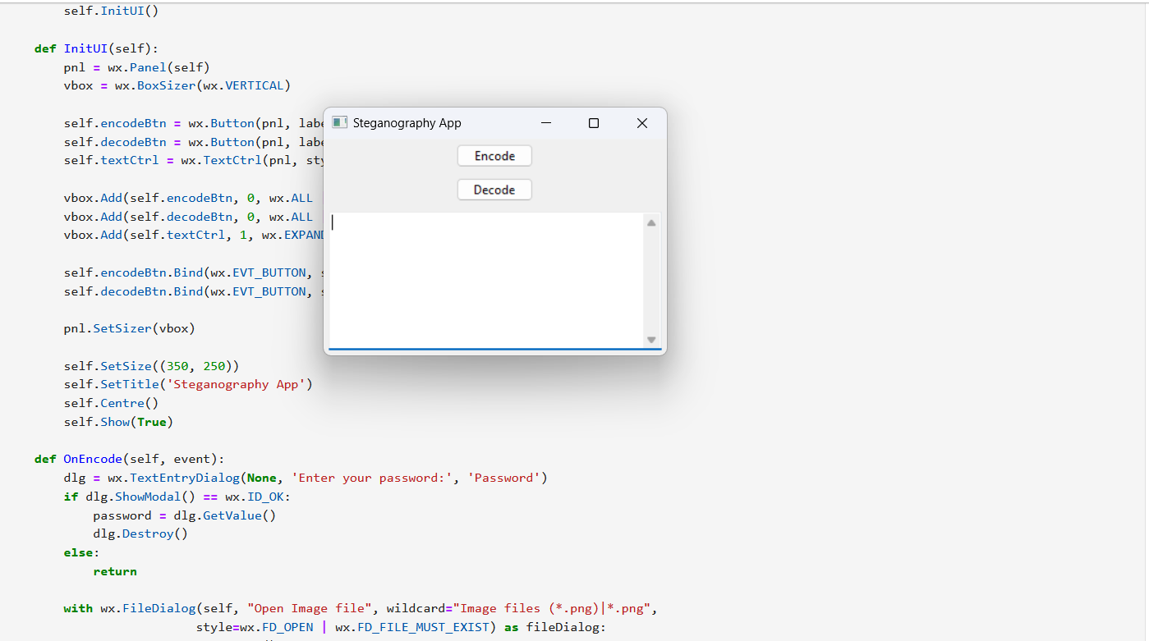
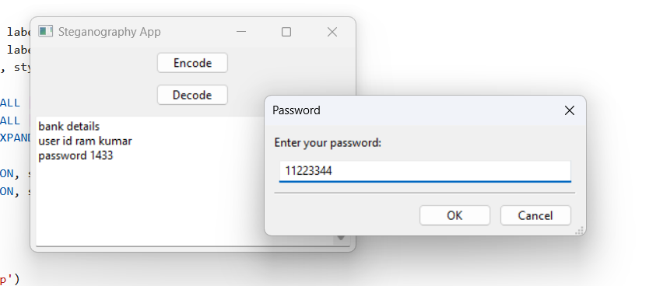
Result

Slide 8
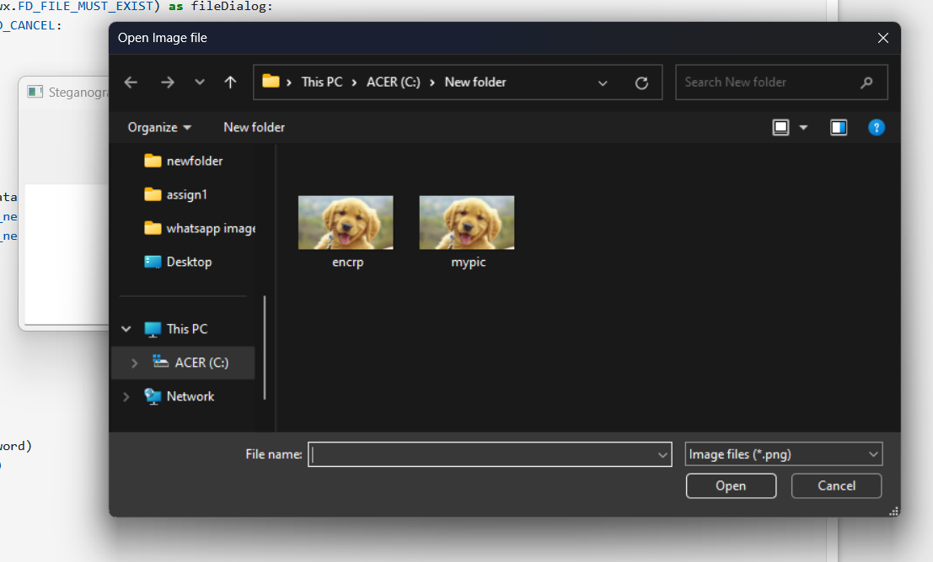
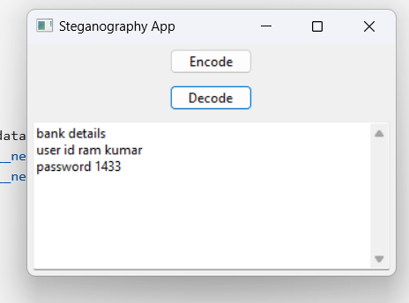

Slide 9
Conclusion
This project successfully implements a steganography application using LSB encoding and XOR encryption for secure message hiding in images. The GUI-based approach ensures user-friendly interaction for encoding and decoding messages. While the method provides basic security, stronger encryption can enhance protection. The application demonstrates the feasibility of image-based data concealment, balancing security and simplicity.

Slide 10
GitHub Link
https://github.com/AbishekMurali07/Secure-Data-Hiding-in-images-Using-Steganography.git

Slide 11
Future scope
Integration with AI and Deep Learning
Steganography in Cloud and IoT Security
Blockchain and Steganography
Medical and Defence Applications

Slide 12
THANK YOU

